Slide 1
Semantic Search Engine for CVPR 2026 Academic Literature

Slide 2
Project Goals:
Bridge the Information Gap
Make the published conference data readily accessible and actionable for the Spaik community.
Tailored Search Methodology
Adapt an efficient search and retrieval methodology customized to the specific scientific domains of interest to our community.
Strategic Alignment
Equip and focus our representatives ahead of the next conference, ensuring targeted attendance and maximum return on participation.

Slide 3
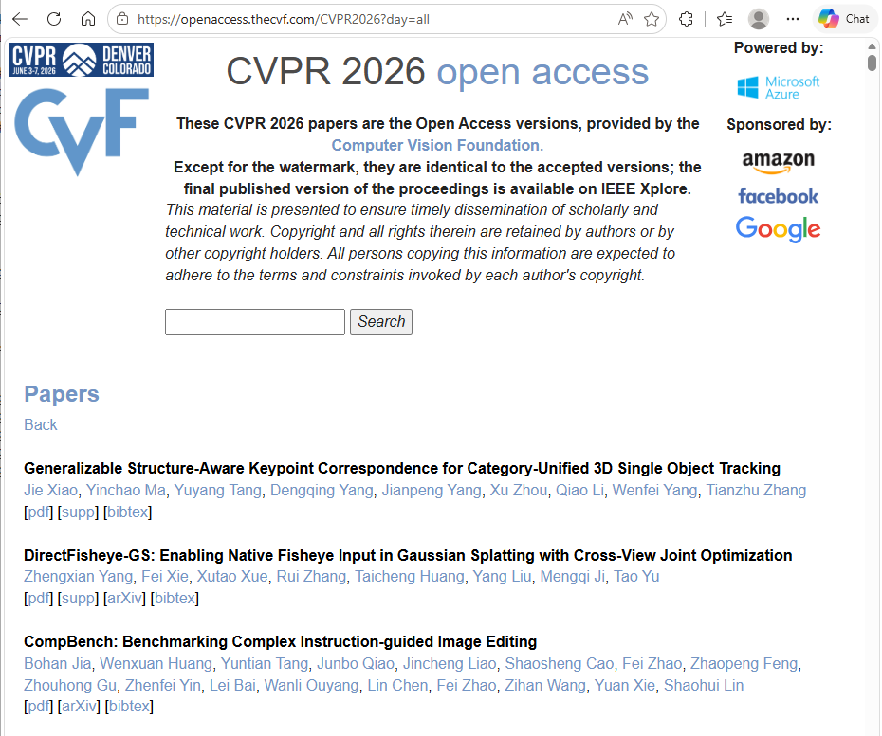
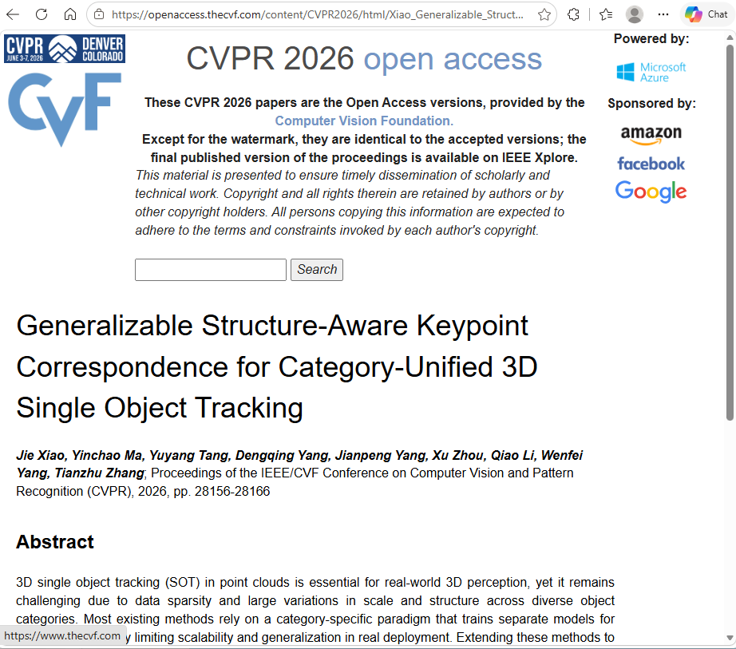
Project stages
Download: Created a Python script to download 4,072 PDFs along with their HTML abstracts.
Database Class: Developed a Python class to fetch the title, PDF path, and abstract based on a given index.
Model Loading: Downloaded and loaded the pretrained BAAI/bge-large-en-v1.5 model.
Semantic Matrix: Generated the semantic matrix utilizing the neural network.
Search Function: Wrote a Python function that executes the search and returns the top 20 result indexes, sorted by relevance.
Web Interface: Developed a website to provide accessible search capabilities and document viewing.

Slide 4
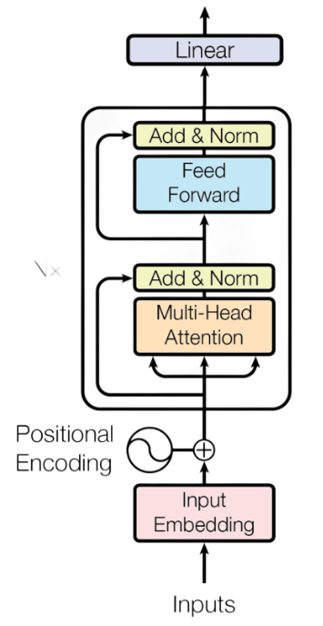
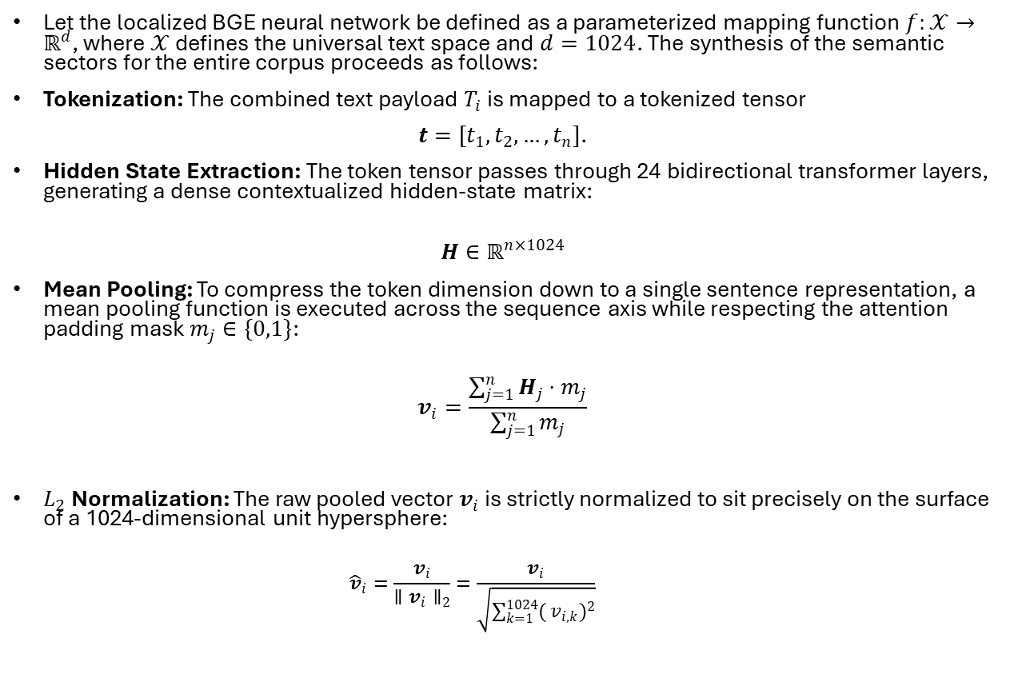
Encoder-only transformer
Let the localized BGE neural network be defined as a parameterized mapping function $f:𝒳→ℝ^{d}$, where $𝒳$ defines the universal text space and $d=1024$. The synthesis of the semantic sectors for the entire corpus proceeds as follows:
Tokenization: The combined text payload $T_{i}$ is mapped to a tokenized tensor
$t=[t_{1},t_{2},…,t_{n}]$.
Hidden State Extraction: The token tensor passes through 24 bidirectional transformer layers, generating a dense contextualized hidden-state matrix:
$$H∈ℝ^{n×1024}$$
Mean Pooling: To compress the token dimension down to a single sentence representation, a mean pooling function is executed across the sequence axis while respecting the attention padding mask $m_{j}∈\{0,1\}$:
$$v_{i}=\frac{\sum_{j=1}^{n}{H_{j}}⋅m_{j}}{\sum_{j=1}^{n}{m_{j}}}$$
$L_{2}$ Normalization: The raw pooled vector $v_{i}$ is strictly normalized to sit precisely on the surface of a 1024-dimensional unit hypersphere:
$${\hat{v}}_{i}=\frac{v_{i}}{∥v_{i}∥_{2}}=\frac{v_{i}}{\sqrt{\sum_{k=1}^{1024}{(}v_{i,k})^{2}}}$$

Slide 5
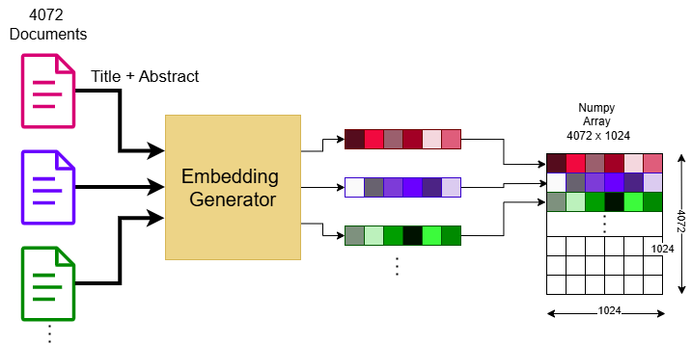
Generate the documents’ Semantic matrix

Slide 6
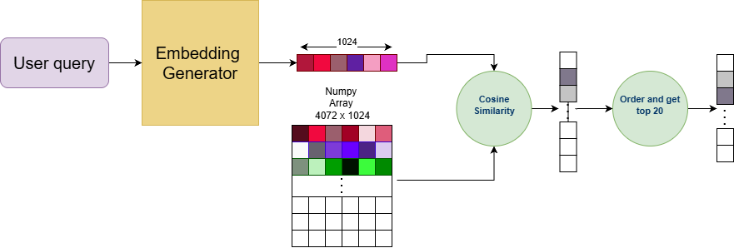
Searching process

